Slide 1
DISCOVER E
LET’S MAKE A DIFFERENCE
National Engineers Week
Feb 16-22, 2020

Slide 2
INTRODUCTIONS
Name
Degree
Job
I became an engineer because…
My favorite project has been…

Slide 3
WHAT IS ENGINEERING?
Engineers turn ideas into reality
They dream up creative and practical solutions to solve real world problems.
Engineers work in teams to invent, design, and create things that matter.

Slide 4
TYPES OF ENGINEERING
AEROSPACE
BIOMEDICAL & BIOENGINEERING
CIVIL
CHEMICAL
COMPUTER
ELECTRICAL
ENVIRONMENTAL
INDUSTRIAL
MANUFACTURING
MECHANICAL
NUCLEAR
PETROLEUM

Slide 5
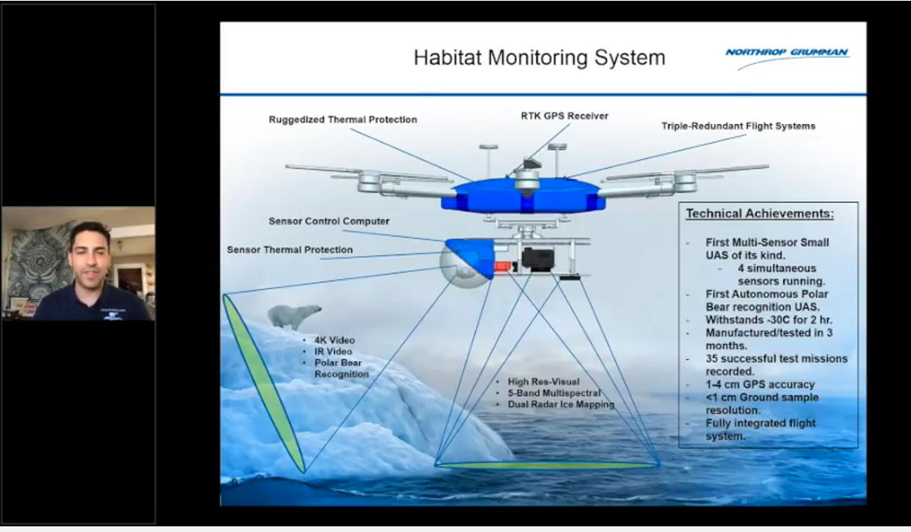
WHAT DOES AN ENGINEER DO?
Charlie Welch
Aerospace engineer who designed a drone to study sea ice and polar bears in Antarctica

Slide 6
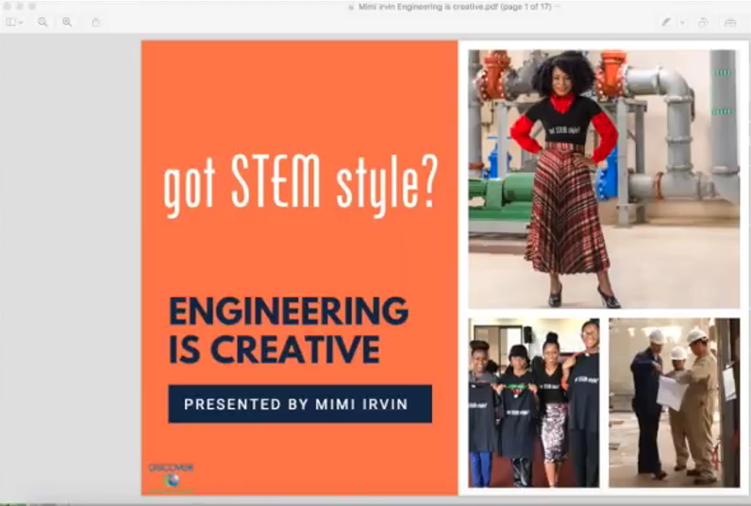
WHAT DOES AN ENGINEER DO?
Mimi Irvin
Electrical engineer designing electrical substations in Kazakhstan

Slide 7
HOW MUCH DOES AN ENGINEER MAKE?
AEROSPACE $67,850 - $158,700
BIOMEDICAL & BIOENGINEERING $52,480 - $139,520
CIVIL $52,900 - $129,850
CHEMICAL $59,470 - $157,160
COMPUTER $64,600 - $159,850
ELECTRICAL $63,430 - $151,990
ENVIRONMENTAL $50,230 - $128,440
INDUSTRIAL $53,470 - $126,920
MANUFACTURING $53,300 - $126,920
MECHANICAL $53,640 - $128,430
NUCLEAR $66,650 - $152,220
PETROLEUM $74,880 - $185,050

Slide 8
WHAT DO I NEED TO DO?
RECOMMENDED COURSES (High School):
4 years of math – Algebra I and II, Trigonometry, Calculus
4 years of Science – Biology, Chemistry, Physics, Ecology, Earth Sciences, Astronomy
4 years of Language Arts (English)
Language Arts Electives – Debate/Speech, communications/media, journalism
3 years of a Foreign Language – your choice

Slide 9

ENGINEEERING CONNECTIONS
Building a bridge is an example of a hard problem that civil engineers know how to solve.
They have the knowledge on how to plan, design, build, and test a bridge so that we don’t have to worry about whether or not it is strong enough for us to cross.
To make a safe bridge that will last a lifetime, engineers often look at other bridges and try to imagine ways to improve on that existing design.
They learn from mistakes made in the past, and make old designs even better!

Slide 10
PROJECT – STRONGEST SHAPES
The Dragon Bridge in Vietnam uses arches that look like a dragon.

Slide 11
PROJECT – STRONGEST SHAPES
Do you know what the strongest shape is? Engineers design structures using shapes that support a lot of weight without collapsing.
Think about bridges you have seen. Did you notice any shapes that are repeated?
Today you can experiment with shapes and think like an engineer to build a bridge.
Using index cards, build a bridge that can support the weight of one die-cast toy car across an 8-inch span.

Slide 12
PROJECT – STRONGEST SHAPES
TEST YOUR BRIDGE!
TEST 1
Place your bridge flat on the table or floor.
Place a die cast car on top. Did your bridge support the weight of 1 car without collapsing?
TEST 2
Place your bridge between 2 chairs or stacks of books.
Place a die cast car on top. Did your bridge support the weight of 1 car without collapsing?
Whose bridge will hold the most weight?

Slide 13





THANK YOU!
Thanks to our local sponsors and teachers for helping with Engineers Week!

