Slide 1
DISCOVER E
LET’S MAKE A DIFFERENCE
National Engineers Week
Feb 16-22, 2020

Slide 2
INTRODUCTIONS
Name
Degree
Job
I became an engineer because…
My favorite project has been…

Slide 3
WHAT IS ENGINEERING?
Engineers turn ideas into reality
They dream up creative and practical solutions to solve real world problems.
Engineers work in teams to invent, design, and create things that matter.

Slide 4
TYPES OF ENGINEERING
AEROSPACE
BIOMEDICAL & BIOENGINEERING
CIVIL
CHEMICAL
COMPUTER
ELECTRICAL
ENVIRONMENTAL
INDUSTRIAL
MANUFACTURING
MECHANICAL
NUCLEAR
PETROLEUM

Slide 5
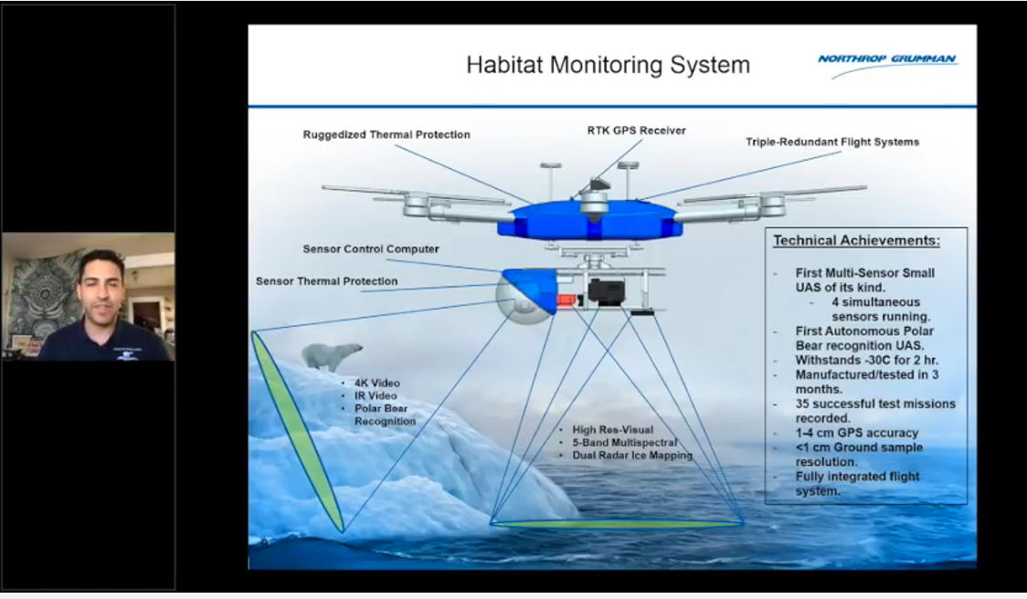
WHAT DOES AN ENGINEER DO?
Charlie Welch
Aerospace engineer who designed a drone to study sea ice and polar bears in Antarctica

Slide 6
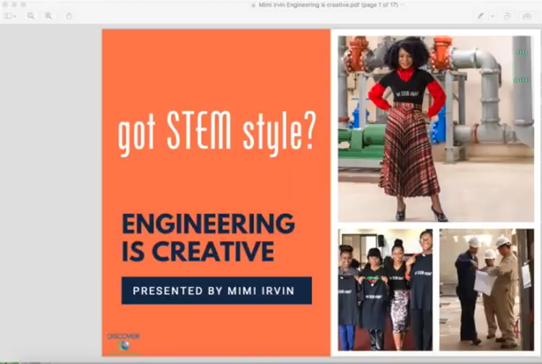
WHAT DOES AN ENGINEER DO?
Mimi Irvin
Electrical engineer designing electrical substations in Kazakhstan

Slide 7
HOW MUCH DOES AN ENGINEER MAKE?
AEROSPACE $67,850 - $158,700
BIOMEDICAL & BIOENGINEERING $52,480 - $139,520
CIVIL $52,900 - $129,850
CHEMICAL $59,470 - $157,160
COMPUTER $64,600 - $159,850
ELECTRICAL $63,430 - $151,990
ENVIRONMENTAL $50,230 - $128,440
INDUSTRIAL $53,470 - $126,920
MANUFACTURING $53,300 - $126,920
MECHANICAL $53,640 - $128,430
NUCLEAR $66,650 - $152,220
PETROLEUM $74,880 - $185,050

Slide 8
WHAT DO I NEED TO DO?
RECOMMENDED COURSES (High School):
4 years of math – Algebra I and II, Trigonometry, Calculus
4 years of Science – Biology, Chemistry, Physics, Ecology, Earth Sciences, Astronomy
4 years of Language Arts (English)
Language Arts Electives – Debate/Speech, communications/media, journalism
3 years of a Foreign Language – your choice

Slide 9
ENGINEEERING CONNECTIONS
Without shock absorbers, riding in a car would be both uncomfortable and dangerous! Not only do the shock absorbers create a comfortable ride by smoothing out bumps, but they also keep the tires on the road at all times.
But shock absorbers aren’t used only in cars. They also protect buildings from earthquakes and make landing gear safer for airplanes and spacecraft.
Shock absorbers are mechanical hydraulic devices. They use pressurized liquids to transfer energy from one type to another.
Shock absorbers dampen the effects of shock waves by converting the kinetic energy of the waves into heat energy that can be transferred into the hydraulic fluid.
They are usually made of a cylinder containing a piston and springs that move up and down as a result of the vibrations caused by the shock.
As the piston moves up and down, the hydraulic fluid is compressed and reduced, thereby transforming the “shocking” kinetic energy into thermal energy, which can be easily dissipated into the surrounding environment.

Slide 10

PROJECT – TOUCHDOWN
How do you protect an astronaut from being crushed by the forces of lift-off?
NASA spacecraft require shock-absorbing devices. Rockets shake violently as they launch and landers touch down on places like the Moon or Mars with a great deal of force.
Without shock absorbers, these extreme vibrations on launch would shake the astronauts with a force 5–6 times stronger than Earth’s gravity or destroy the delicate equipment in the landers when they reached these places in the solar system.

Slide 11
PROJECT – TOUCHDOWN
Design, build, and test shock absorbers for a spacecraft lander.
Lander consists of a platform (white index cards) with shock absorbers underneath and a crew cockpit (cup).

Slide 12
PROJECT – TOUCHDOWN
TEST YOUR SPACECRAFT LANDER!
TEST 1
Place 1 or 2 marshmallow astronauts, uncovered, in the cup and drop it from a height of 1 foot.
Did the spacecraft land on the shock absorbers?
How well did the shock absorbers soften the impact of landing?
Did your astronauts land safely and remain in the cup?
TEST 2
Keep increasing your drop height until you find the limit of your shock absorbers.
Whose spacecraft lander can protect the astronauts from the highest drop?

Slide 13





THANK YOU!
Thanks to our local sponsors and teachers for helping with Engineers Week!

